Slide 1
Female reproductive system
By
Dr. Fatin latef

Slide 2
It is divided in to the following structural units:
1-paired ovaries.
2-paired oviducts (fallopian tube).
3-uterus-cervix.
4-vagina.
Functions:
_production of female gametes, ovum and reception of spermatozoa.
_providing a suitable environment for fertilization &implantation of the fertilized ovum.
_expulsion of the fetus, produce female sex hormones.
_houses and nourish conceptus during pregnancy.

Slide 3
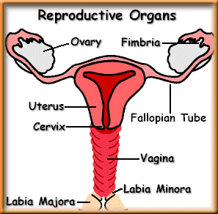
Major Organs

Slide 4
Which is the ovay?

Slide 5
Ovaries
Are almond- shaped bodies approximately 3cm long, 1.5 cm wide, 1cm thick, paired gland act as:
-exocrine function, maturation and release of oocyte.
-endocrine function, secretion of estrogen and progesterone.
The ovary is subdivided in to:
Cortex
Medulla
Each ovary is covered by a simple cuboidal epithelium, the germinal epithelium continuous with the mesothelium and overlying a layer of dense connective tissue capsule, the tunica albuginea.

Slide 6
Most of the ovary consist of the cortex, region filled with a highly cellular c t stroma and many ovarian follicles, which in the adult ovary vary greatly in size.
The most internal part of the ovary is the medulla, which contains loose c t and blood vessels entering the organ through the hilum, there are no sharp limits between the ovarian cortical and medullary regions.
The surface epithelium of the ovary is called the mesothelium which change at the hilum in to cuboidal epithelium (germinal epithelium), which sits on the tunica albuginea.
The hilus of the ovary is where all nerves and vessels enter the organ.

Slide 7
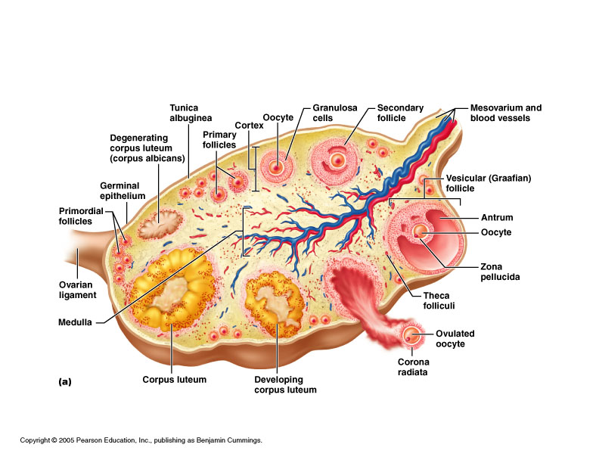
Structure of ovary

Slide 8
Oogenesis
Is the process by which a diploid somatic cell, an oogonium in the fetal ovary becomes a haploid ovum in the adult after fertilization. Takes place inside ovarian follicles in ovaries a part of ovarian cycle.
Stages :
Oogonia: in the fetal ovary divide mitotic ally to form diploid primary oocyte at are located in primordial follicles.
Primary oocyte: immediately begin the first meiotic division, which arrests a prophase. Primordial follicles present from birth until puberty, resulting in ovulation.
Secondary oocyte: is formed during the hours preceding ovulation in each ovarian cycle. that is ovulated, begins meiosis II but arrest in metaphase.

Slide 9
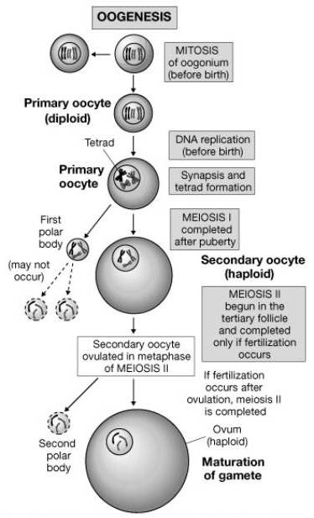
An ovum: the mature haploid germ cell is formed only if fertilization occurs.

Slide 10
Ovarian follicles
An ovarian follicles consists of an oocyte, granulosa cells, and theca cells surrounded by one or more layers of epithelial cells. the follicles that are formed during fetal life, main functional unit of the ovary.
Stages of follicular growth:
Primordial follicles:
consist of a primary oocyte enveloped by a single layer of the flattened follicular cells form a simple squamous epithelium around the oocyte.
Beginning in puberty with the release of follicle-stimulating hormone (FSH) from the pituitary, a small group of primordial follicles each month begins a process of follicular growth. This involves growth of the oocyte, proliferation and changes.

Slide 11
Primary follicle:
Prompted by FSH, an oocyte grows most rapidly during the first part of follicular development, reaching a maximum diameter of about 120µm.the nucleus enlarges; mitochondria become more numerous and uniformly distributed, contain the following:
Primary unilaminar follicle:
contain a primary oocyte and follicular cells form a simple columnar epi. Around the oocyte.
Primary multilaminar follicle:
Follicular epithelium, the granulosa, in which the cells communicate through gap junctions. Follicle cells are now termed granulosa cells, the follicular cells continue to proliferate , forming a stratified granulosa cells.
Between the oocyte and the granulosa cells, a layer of extracellular material a homogenous glycoprotein membrane called zona pellucida develops.
Theca folliculi, a layer located outside the basement membrane of the follicular cells.

Slide 12
Secondary or antral follicles:
As the follicles grow with increasing oocyte size and numbers of granulosa cells, they move deeper in the ovarian cortex.
Small spaces develop within the granulosa layer as the cells secrete follicular fluid or (liquor folliculi).
This fluid accumulates in the spaces gradually and the granulosa cells reorganize themselves around a larger cavity, the antrum, producing follicles now called secondary or antral follicles.
Follicular fluid: contains hyaluronate, growth factors, plasminogen, fibrinogen, the anticoagulant heparan sulfate proteoglycan, and high concentrations of steroids (progesterone &estrogen) with binding proteins.

Slide 13
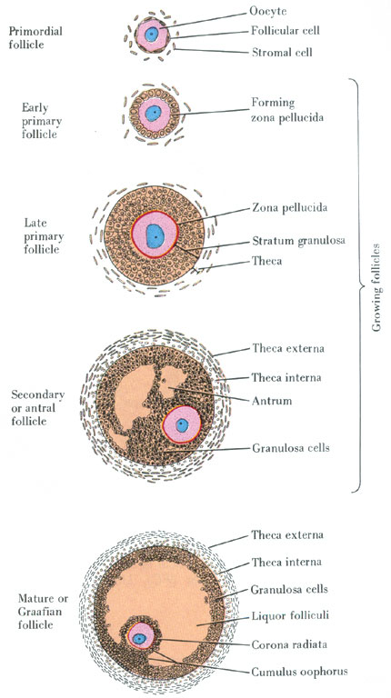

Slide 14
During the reorganization of the granulosa layer to form the antrum, some cells form a small hillock, the cumulus oophorus, surrounding the oocyte and protruding in to the antrum.
The granulosa cells immediately around and linked to the oocyte make up the corona radiata and accompany the oocyte when it leaves the ovary.
While the follicle develops, the stromal cells immediately around the follicle differentiate to form the follicular theca (theca folliculi), outer covering.
This layer subsequently differentiate further as two tissues around the follicle; a well vascular zed endocrine tissue, the theca interna( is composed of cells that secret the steroid hormone androgen) and a more fibrous outer theca externa containing smooth muscle and fibroblast.

Slide 15
The thecal cell also continue to differentiate in to theca interna and externa, during each menstrual cycle usually one follicles grows much more than the other and become the dominant follicle, while many of other follicles eventually enter atresia (most ovarian follicles undergo the degenerative process called atresia, in which follicular cells and oocytes die and disposed of by phagocytic cells, follicles at any stages of development including nearly mature follicles, may become atretic).granulosa and theca interna cells begin formation of corpus luteum.

Slide 16
Enlarged follicle bulges from the ovarian surface, thinning the ovarian tissue covering the follicle and forming a stigma (is translucent ischemic area, in which the compaction of the tissue has blocked blood flow within and around the mature follicle which rapidly weaken the granulosa layer and the cumulus oophorus as well as the overlying tunica albuginea.

Slide 17
Follicular growth and maturation is influenced by follicle stimulating hormone (FSH), secret by the pituitary gland, and estrogen.
Mature graafian follicle:
Follicle need 12-14 days to become fully matured, it is about 1cm in diameter, it shows a very large single antrum filled with follicular fluid.
The oocyte now in eccentric in position, projects in to this fluid-filled cavity, the oocyte is still surrounded by zona pellucida, still surrounded by granulosa cells which now make up the corona radiata (CR), outside the zona pellucida.
The corona radiata and oocyte are attached to the side of the follicle via a less mass of granulosa cells called the cumulus oophorus which is continuous with remaining granulosa cells.

Slide 18
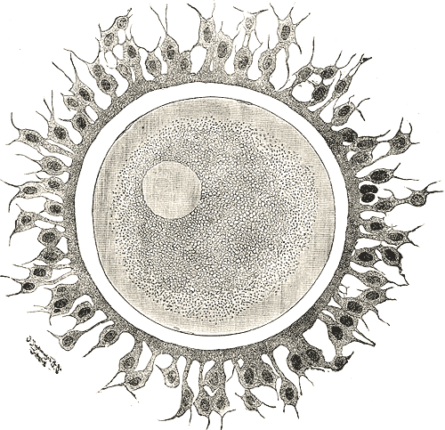
Ovulation
ovulation consist of the rupture of part of the wall of the mature follicle and liberation of the oocyte( Ovarian wall ruptures and egg released, surrounded by its corona radiata).it takes place in approximately the middle of the menstrual cycle, around the fourteenth day of a 28- day cycle.

Slide 19
In the human, usually only one oocyte is liberated by the ovary during each cycle, but sometimes no oocyte is ovulated (anovulatory cycle).
Some time two or more oocytes can be expelled at the same time, and if they are fertilized, there may be two or more fetuses.
The stimulus for ovulation is a surge of luteinizing hormone(LH) secreted by the anterior pituitary gland in response to high levels of circulating estrogen produced by the growing follicles.
The increasing pressure of the follicular fluid and weakening of the follicular wall lead to rupture of the ovarian surface at the stigma.

